Slide 1
CS 435
IBM Cloud Sponsored by Power Systems Academic Initiative
Andrew Zhu, Mohammed Tarek, Rachel Tan

Slide 2
Problem Statement
Hobby matching app
Users make an account providing: username, password, name, location, and hobbies
Upon joining users can create or join groups centered around a hobby
If creating a group, the user provides: group name and hobby
Members of groups can chat through a chat feature
Members of groups can create events to meet up with each other, by providing a date, time, and location

Slide 3
Table Attributes
User: username, password, name, address, and interests
Group: name, members, interest
Event: name, date, location, participants, interest
Chat: sender, receiver(s), message

Slide 4
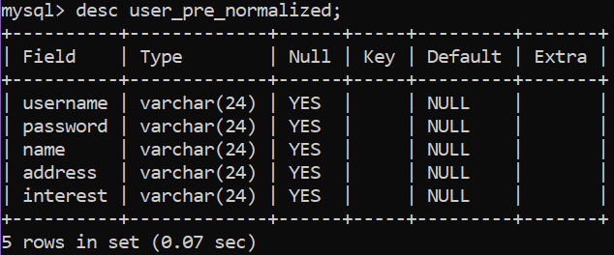
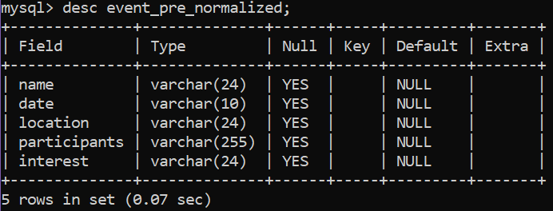
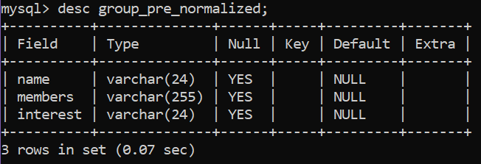
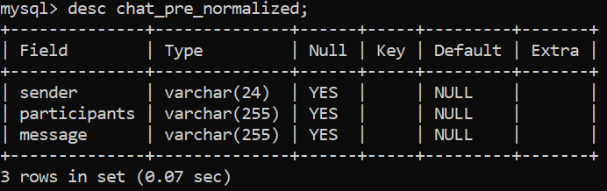
Pre-Normalized Table Definition
User Table
Event Table
Group Table
Chat Table
Notes:
Pre-normalized tables have:
no primary keys
no bridging tables to handle many to many relationships
partial and transitive dependency

Slide 5
1st Normal Form
Atomic fields:
user table: username, password, first_name, last_name, city, state, interests
events table: name, date, city, state, participants, interest
Primary keys:
user id, group id, event id, chat id
Repeating records: table does not have repeating records
Notes:
created atomic fields for user and events table
every record in each table is now identified by a primary key

Slide 6
2nd Normal Form
Table is 1NF
No partial dependency:
columns in each table depend on the primary key created in 1NF
primary keys: user id, group id, event id, chat id
use of ID for each record removes the need for a composite key
lack of a composite key removes partial dependency

Slide 7
3rd Normal Form
Table is in 2NF
Remove transitive dependency:
participants column in event and chat table depend on the members column in group_ table
members column is a not a primary key
user_group table: new table to represent member column
pairs user_id with group_id
group_ table removes member column
chat and event table now relate to group_ table with group ID (primary key of group_ table)

Slide 8
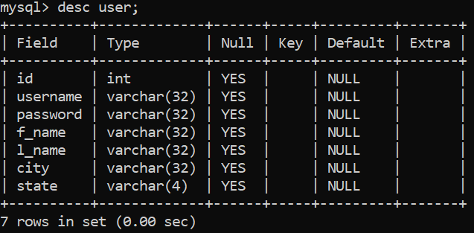
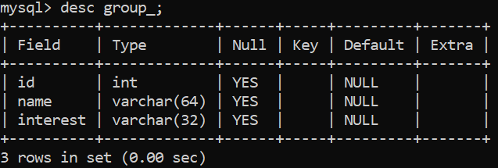
Normalized Tables
user table:
create table user (id int, f_name varchar(32),
l_name varchar(32), city varchar(64), state varchar(4));
load data local infile
'/home/2020/hunter/fall/43501/za0253/project/user.csv' into
table user fields terminated by ',' optionally enclosed by
'"' ignore 1 lines;
group table:
create table group_ (id int, name varchar(64), interest
varchar(32));
load data local infile
'/home/2020/hunter/fall/43501/za0253/project/group.csv'
into table group_ fields terminated by ',' optionally
enclosed by '"' ignore 1 lines;

Slide 9
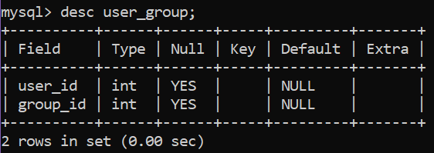
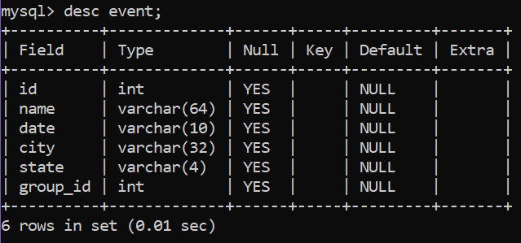
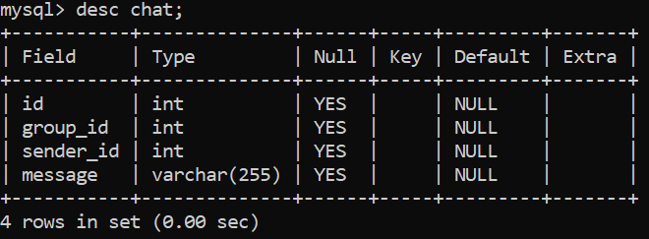
user_group table:
create table user_group (user_id int, group_id int);
load data local infile
'/home/2020/hunter/fall/43501/za0253/project/user_group.csv'
into table user_group fields terminated by ',' optionally
enclosed by '"' ignore 1 lines;
event table:
create table event (id int, name varchar(64),
date varchar(10), city varchar(32), state varchar(4),
group_id int);
load data local infile
'/home/2020/hunter/fall/43501/za0253/project/event.csv'
into table event fields terminated by ',' optionally
enclosed by '"' ignore 1 lines;
chat table:
create table chat (id int, group_id int, sender_id int,
message varchar(255));
load data local infile
'/home/2020/hunter/fall/43501/za0253/project/chat.csv' into
table chat fields terminated by ',' optionally enclosed by '
"' ignore 1 lines;

Slide 10
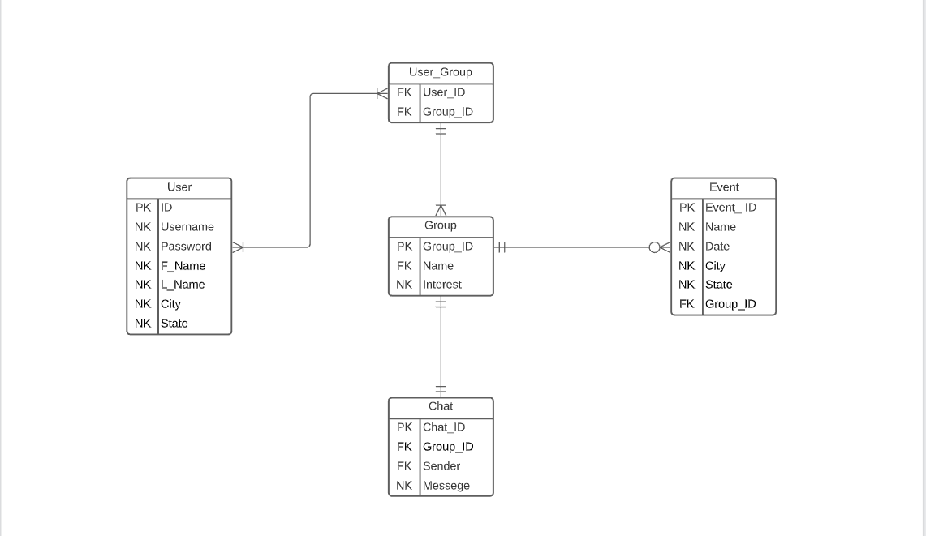
ER Diagram

Slide 11
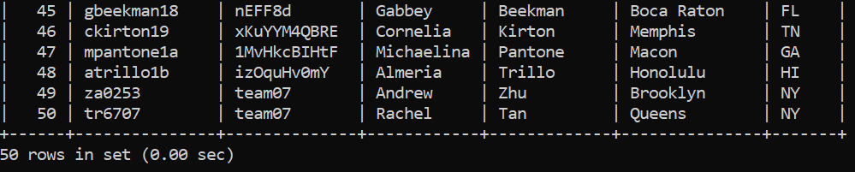
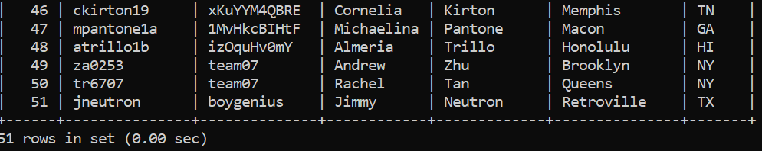
Queries (user)
show all users: select * from user;
create user: insert into user (id, username, password, f_name, l_name, city, state) select (select max(id)+1 from user), 'jneutron', 'boygenius', 'Jimmy', 'Neutron', 'Retroville', 'TX';

Slide 12
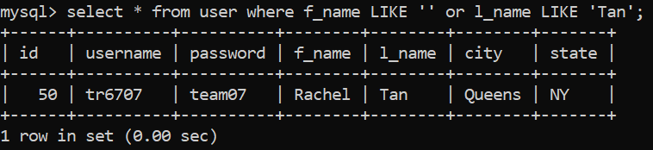
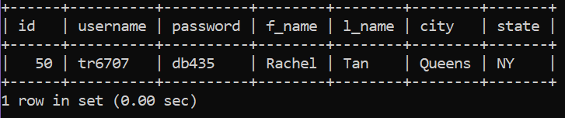

Queries (user)
search for user by first or last name:
update user info: update user set [column name] = '%REPLACE%' where id = %REPLACE%;
Search for user by username:

Slide 13
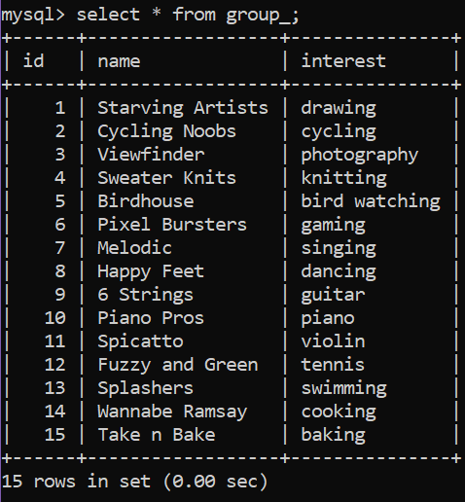
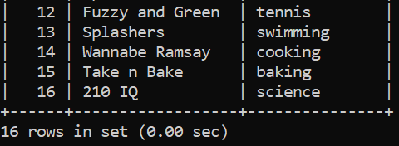
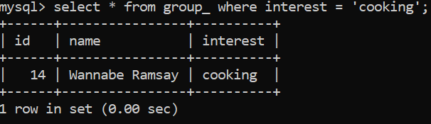
Queries (group_)
create group: insert into group_ (id, name, interest)
select (select max(id)+1 from group_), '210 IQ',
'science';
show all groups:
search for group by interest

Slide 14
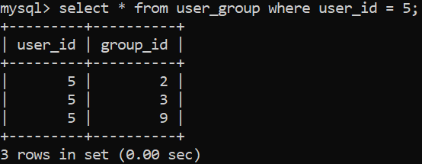
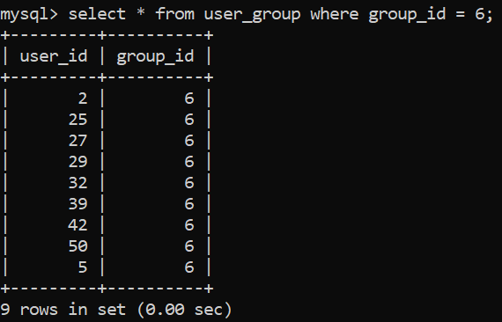
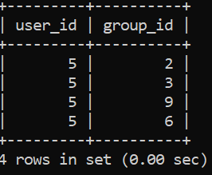
Queries (user_group)
show what groups a user is in
show members in a group
add user to a group: insert into user_group
values (5, 6);

Slide 15
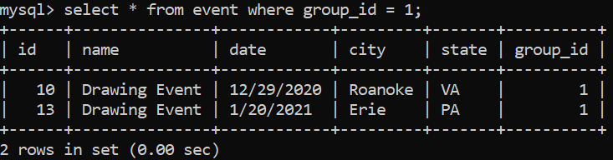
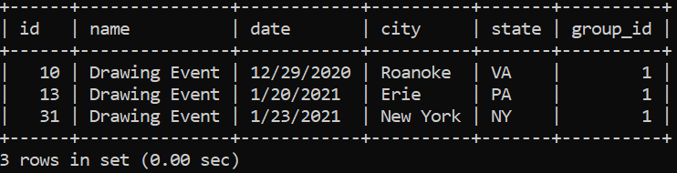
Queries (event)
show all events in a group by group id:
create new event: insert into event (id, name, date, city, state, group_id) select (select max(id)+1 from event), 'Drawing Event', '1/23/2021', 'New York', 'NY', 1;

Slide 16
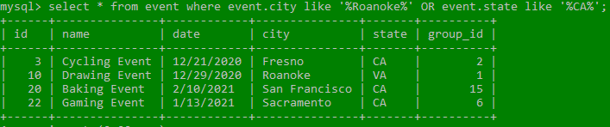
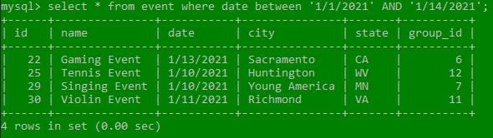
Queries (event)
Return event by location:
Return by date range:

Slide 17
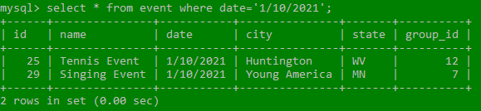
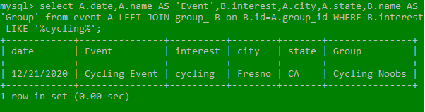
Queries (Event)
Return by specific date:
Return by interest: select A.date,A.name AS 'Event',B.interest,A.city,A.state,B.name AS 'Group' from event A LEFT JOIN group_ B on B.id=A.group_id WHERE B.interest LIKE '%REPLACE%';

Slide 18
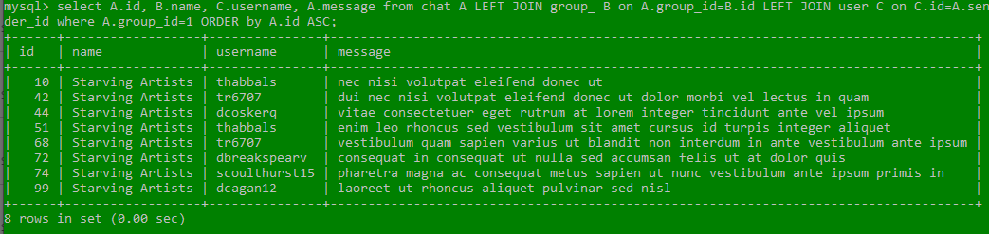
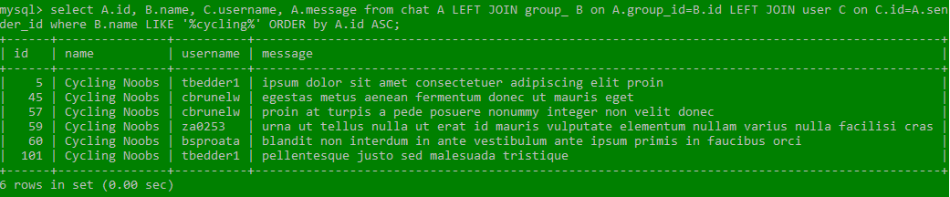
Queries (chat)
show group chat by group id: select A.id, B.name, C.username, A.message from chat A LEFT JOIN group_ B on A.group_id=B.id LEFT JOIN user C on C.id=A.sender_id where A.group_id=1 ORDER by A.id ASC;
show group chat by group name: select A.id, B.name, C.username, A.message from chat A LEFT JOIN group_ B on A.group_id=B.id LEFT JOIN user C on C.id=A.sender_id where B.name LIKE '%cycling%' ORDER by A.id ASC;

Slide 19
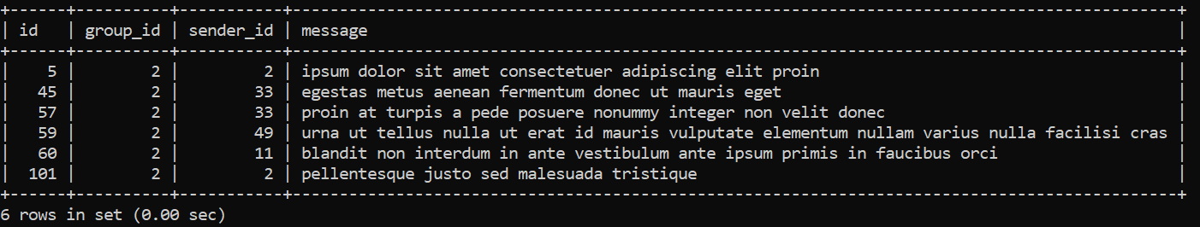
Queries (chat)
send message: insert into chat (id, group_id, sender_id, message) select (select max(id)+1 from chat), 2, 2, 'pellentesque justo sed malesuada tristique';

